Slide 1

Introduction
Dr. Tawfiq Barhoom
20232

Slide 2
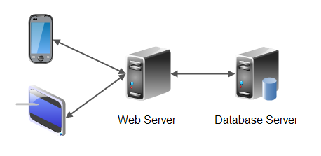
N-Tier Architecture
N >=3

Slide 3
HTML
Javascript
CSS
PHP, ASP, …
XML

Slide 4
HTML
HyperText Markup Language
set of markup tags
Tag: describ different document content
<tagname> content </tagname>

Slide 5
Tags examples
START TAG END TAG
<HTML> </HTML>
<HEAD> </HEAD>
<TITLE> </TITLE>
<BODY> </BODY>
<H1>, <H2>, ... </H1>, </H2>, ...
<IMG ...> </IMG> (optional)
<A ...> </A>
<P> </P>
<BR/> (none; "empty" tag)
<OL> </OL>
<UL> </UL>
<LI> </LI>

Slide 6
Html document example
<html>
<head>
<title>First document</title>
</head>
<body>
<h1>this is my first page</h1>
<p> simple page example </p>
</body>
</html>

Slide 7

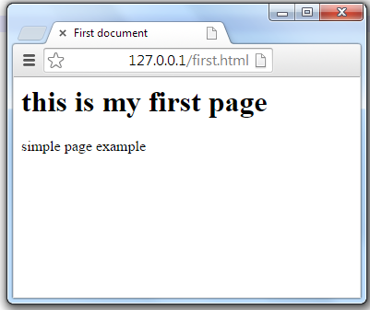
Browser

Slide 8
JavaScript
Extension to HTML (client side)
object-based scripting language
is event-driven
What is for
Interactivity with the page user:
input - processing - output

Slide 9
CSS
Control the page layout
fonts and text , Page background,..ect
rule
h2 { font-style : italic ; }
property value
selector declaration

Slide 10
PHP
PHP document Consist:
HTML + JavaScript + CSS + PHP code
HTML + JavaScript + CSS ➔ rendered at client side
PHP code interpreted at server side ➔ result any thing, but usually html tags + JavaScript + CSS ➔ rendered at client side
embedded within a <?php … ?> tag

Slide 11
PHP
<html>
<head>
<title>PHP test</title>
</head>
<body>
<?php echo “<p>Hello World</p>"; ?>
</body>
</html>

Slide 12
PHP
<html>
<head>
<title>PHP test</title>
</head>
<body>
<p>Hello world!</p>
</body>
</html>
PHP code has been replaced, in the message body, by its output

Slide 13
Server side Vs Client side
PHP Vs HTML + CSS + javascript
Apache Server Vs Browser
PHP ➔ HTML + CSS + javascript

Slide 14
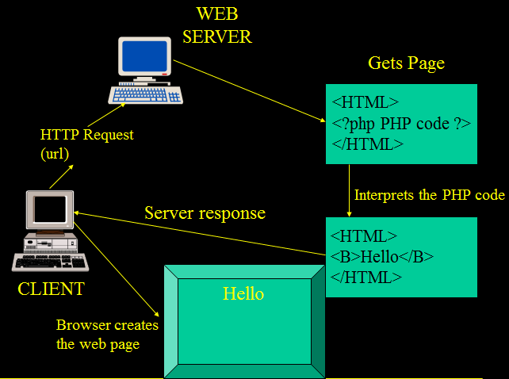

Slide 15
Database
A database is an organized collection of data whose content must be quickly and easily (Accessed, Managed, Updated)
A relational database is one whose data are split up into tables, sometimes called relations
Structured Query Language (SQL)
Allows for complete
Table Creation, Deletion, Editing
Data extraction (Queries)
MySQL server – DBMS
PHP connected with to access the data

Slide 16
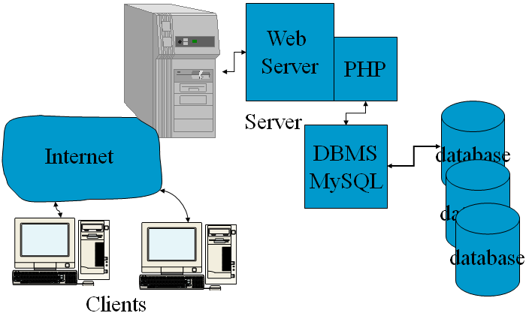

Slide 17
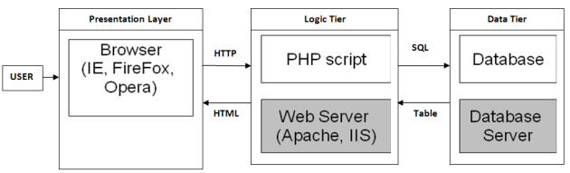

Slide 18
System Architecture
Multi-tier application (n-tier application)
Information tier (data or bottom tier)
Maintains data for the application
Stores data in a relational database management system (RDBMS)
Middle tier
Implements business logic and presentation logic
Control interactions between application clients and application data
Client tier (top tier)
Application’s user interface
Users interact directly with the application through the client tier

Slide 19
Client-Side Scripting versus Server-Side Scripting
Client-side scripts
Validate user input
Reduce requests needed to be passed to server
Access browser
Enhance Web pages with dynamic content
Server-side scripts
Executed on server
Generate custom response for clients
Wide range of programmatic capabilities
Access to server-side software that extends server functionality

Slide 20
This course
Focus on server side
PHP: the script language and related topics
Database utility

